Slide 1
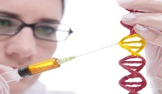
University of Basrah Al-zahraa medical college
Ministry of higher Education and Scientific Researches
The module: Molecules, Genes and Diseases (MGD)
Session 10
Lecture 18
Duration 1 hour
Mutations
Detecting disease-causing mutations
Staff: Dr. Nibras Saleam Al-Ammar
Dr. Hussein K. Abdel-Sada
Dr. Ilham Jawad
Dr. Ihsan Mardan
Dr. Wameedh Hashim
Dr. Muntaha
Dr. Sadeq K. Ali
Human Heredity Chapters 2, 3, 4, 5
Lippincott’s Illustrated Reviews: Cell and Molecular Biology Chapter 20
For more detailed instruction, any question, cases need help please post to the group of session.

Slide 2
Intended learning outcomes of Lecture 18
At the end of this lecture you should be able to:
Recognize the fundamental importance of PCR in the diagnosis of genetic disease. (LO.1)
Provide an overview of the different genetic tests available for the detection of mutations in genes. (LO.2)

Slide 3
(LO.1)
Detection of mutations
Most human mutations are single base substitutions that cause single amino acid substitutions. Hence the problem is to detect a single base change in a background of 3000 million bases of DNA in the human genome.
The entire human genome has been cloned and sequenced. For many genes of clinical interest precise alterations at the DNA have been characterized for common mutations.
For example, all cases of sickle cell anaemia are caused by exactly the same single base A->T mutation. It is possible to design a test for this mutation using allele-specific probes (see below), that can distinguish between the two different alleles in a hybridisation experiment.

Slide 4
(LO.1)

Slide 5
(LO.1)
Most DNA-based clinical diagnoses rely on the PCR amplification of the DNA being tested. Starting with a very small amount of DNA a specific DNA segment around the mutation is amplified to allow detection of the mutation.
Detecting the mutation could follow from, for instance:
information regarding a loss or gain of a restriction enzyme site in the PCR product (e.g. loss of an MstII site in the Sickle Cell mutation).
information regarding the size of the PCR product (e.g. detection of the 3bp deletion in the ΔF508 CF mutation).
presence or absence of a PCR product (e.g. using allele-specific PCR, see below).
DNA sequence of the PCR product.

Slide 6
(LO.1)
For known disease-causing mutations allele-specific PCR tests can also be developed. One common primer (not shown to the left) is used in conjunction with two different allele-specific primers of which the 3’ base corresponds with the base found in one allele or the other (see below).
A PCR product will only be amplified if the allele-specific primer is perfectly matched with the template DNA at its 3’end.

Slide 7
(LO.1)

Slide 8
(LO.2)
Southern Blotting
Not all mutations can be easily detected using PCR-based methods, for instance with (partial) gene inversions (e.g. haemophilia A) the gross organisation of the gene needs to be investigated. Southern blotting allows investigation of an individual gene in a background of all other genes.
It is the technique of choice when there is a need to analyses larger segments of DNA within and around a gene. Southern blotting is also used to analyse triplet repeat disorders, such as Huntington’s disease and Fragile X syndrome.

Slide 9
Array Comparative Genomic Hybridisation (Array CGH):
This technique is used to screen for sub-microscopic chromosomal deletions for which the location cannot be deduced from the patient’s phenotype. An array of DNA probes covering the entire genome is applied to the surface of a solid matrix.
Patient DNA and normal control DNA are each labelled with different colored fluorescent tags (e.g. patient DNA is labelled red and control DNA is labelled green).
Equal amounts of labelled DNA are then hybridized to the probe array and the hybridization signals are detected and compared.
For probes where the signal of the control DNA exceeds that of the signal of the patient’s DNA (i.e. in our example the signal is more green than red), the patient has a deletion of the chromosomal region from which that probe was derived.
(LO.2)

Slide 10
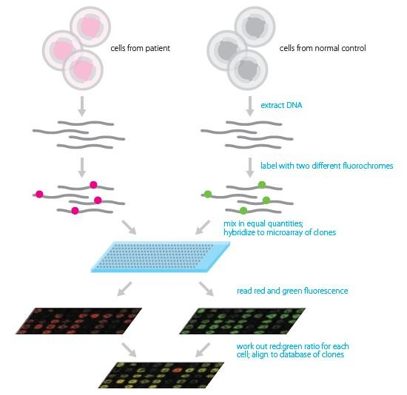
(LO.2)
(LO.2)

